Slide 1
SECURE E-COUPON USING BLOCKCHAIN
P SHRISHTI CLINT
S4 MCA B,27

Slide 2
RELEVANCE
Digital coupons are discounts/offers that are aimed at tempting costumers to make purchase at online market.
Discount coupon tampering in a retail chain is one of the biggest problems in the business domain.
A manufacturer distributes their product to the retailers where they provide discounts to the products. All the retailers get access to the discount coupons of the products and this is shared to the customers. Customers can redeem the discounts of the product and buy them in low cost.
To solve the tampering in these coupons so that the manufacturers do not face loss we use a secure e-coupon service based on blockchain system.

Slide 3
Description
In this, the retailers can generate coupons for a particular product and can share it with the universe using any social media. The coupons are stored in an open source blockchain platform called Ethereum. With the underlying security mechanism of the ethereum blockchain, our system is tamper-proof.
We generate the coupons as e- coupons(QR-code) into blockchain network as a hash of the product details including the timestamp. Once we do this no one can change them due to the immutability feature provided by the blockchain ,also everyone in the chain can view the sales made.
All retail chain comes under some manufacture, the manufacture publishes some discount coupons to increase their sales, they induce some validity to it, then they release the coupon to the customers. The customers can redeem the coupons from any outlets of the manufacture, where the retailer will collect the coupon verify it and provide the corresponding discount associated.

Slide 4
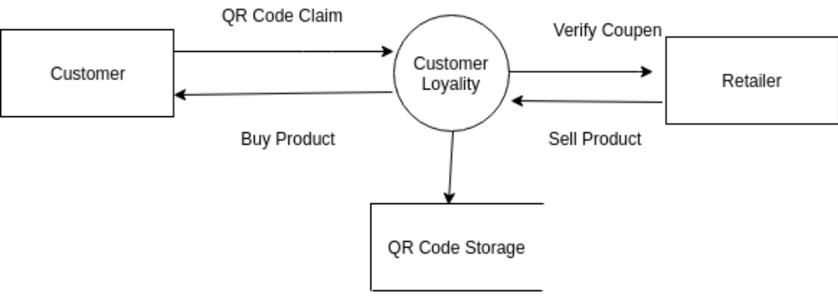
STRUCTURE

Slide 5
OBJECTIVES
To build a system that can completely eliminate the coupon fraud
To maintain soft copies for ensuring that no coupons are lost.
To ensure the end to end security between all user levels.

Slide 6
Existing System
The existing system mainly consists of paper coupons that are distributed and maintained manually.
The manual method is a much more tedious task
The accounting process becomes extremely time consuming. There are issues related to study the market feedback and also a very high proportion of paper coupons are never returned.
Later on, digital coupons were invented. The problem with the digital coupons is that, they get manipulated by some individuals, which causes a lot of loss to the merchants. So in many situations the loyalty of the customer has to be cross validated by the retailers.

Slide 7
Proposed system
The system enables the retail chains to issue coupons. The retailers can verify the coupon when the customer come to redeem it.
It also makes the verification much more efficient by enabling customers and retailers to verify the genuinity of the coupons. And there by enabling the solution to the customer loyalty issues.
This system is much more secure when compared with the existing system.

Slide 8
Modules
RETAIL MARKET SETUP
Registering retailer
Add Product
Adding products with discounts in Ethereum.
Coupon conversion
Converting coupon into hashcode and Qrcode.
Contract Creation
Using solidity a digital contract is signed
Coupon Validation
  Done by retailer , If the customer is valid scanning QR code will show a product associated with QR code.

Slide 9
METHODOLOGY
The proposed system uses the public blockchain technology called Ethereum blockchain and the highly distributed. This system provides the retailers to verify the genuinely of the coupons brought by the customer
Creating the discount coupon
The authenticated retailer can add discount to a particular product with a particualar time validity. Those data was hashed using the sha256 algorithm and was stored in an etherum blockchain. The hashed code will be published and will be shared in various media in the form of a QR code for better representation. Whenever the retailer added a new discount coupon, he can create the respective coupons and will publish it.
Verifying the coupon
The customer can bring those coupons and redeem them for a particular product. A coupon will only work for that particular product. All those constraint checkins was done at the time of verifying. From the scanned QR code, the hash code will be detected, and it will be matched with the particular index of the deployed contract. By using the corresponding index, the aggregate data can be retrieved.

Slide 10
THANK YOU

